Slide 1
Antipsychotic Drugs: Haldol Zyprexa and Thorazine.
Student’s Name:
Institutional Affiliation:

Slide 2
Introduction
Antipsychotic drugs are primarily utilized in treating Schizophrenia and other psychotic states, such as manic states with symptoms of psychotic, for instance, delusions, paranoia, grandiosity as well as hallucinations.
The drugs are not curative but lessen the intensity of the delusions or hallucinations, thereby allowing the patient to function appropriately in a supportive environment.
In this presentation, we shall explore the pharmacology of Haldol Zyprexa and Thorazine.

Slide 3
Haldol
The prescription medicine is used for the treatment of the symptoms of psychosis and Schizophrenia
Its class of drugs is Antipsychotics, 1st Generation, Moderate, CYP344 inhibitor.
Haldol, also known as Haloperidol
It is available as a sterile parenteral form for intramuscular injection
Mechanism of Action
Phenylbutylpiperadine: antagonizes the dopamine D1 and D2, which are brain receptors.
It depresses the reticular activating system and inhibits hypothalamic and hypophyseal hormones release.

Slide 4
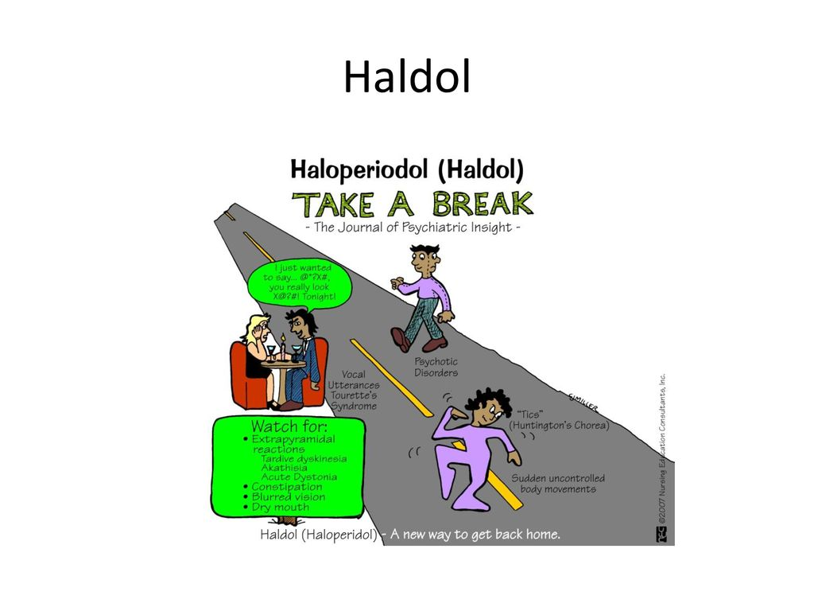
Haldol :Possible Side Effects
Haldol causes severe effects, including;
Sudden Mood Changes
Neck Stiffness
Fever
Agitation
Hallucinations
Seizure
Lightheadedness
Fainting

Slide 5
Zyprexa
Its generic name is olanzapine and brand names Zyprexa or Zyprexa Zydis
Classes: Antipsychotics, 2nd Generation; Antimanic Agents
It is a prescription for schizophrenia symptoms for individuals aging 13 years and more
It is also used in treating bipolar disorder, including mixed states for people aging 13 years or older
Mechanism of Action
Its precise action is not yet known but may work through blockage of receptors for numerous neurotransmitters in the brain.
It binds to alpha-1, histamine H-1, muscarinic, dopamine, and serotonin type 2 receptors

Slide 6

Zyprexa: Side Effects
Akathisia
Drowsiness
Orthostatic hypotension
Insomnia
Weight gain
Constipation
Lightheadedness
Increased Appetite
Stomach upset

Slide 7
Thorazine
Its generic name is chlorpromazine
Classes: Antipsychotics, 1st Generation: Phenothiazine
It is a chlorpromazine antipsychotic brand, a tranquilizer, antiemetic.
It is available in injectable and oral forms.
It is used for treating Schizophrenia, control manic states of manic-depressive conditions.
Mechanism of action: it exerts antiemetic and sedative activity
It antagonizes the dopamine D2 receptors in the brain.
Depresses the reticular activating systems and hypothalamic and hypophyseal hormones release

Slide 8
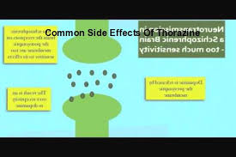
Thorazine: Side Effects
Akathisia
Muscle Stiffness
Infrequent neuroleptic malignant syndrome
Dystonia
Parkinsonism
Weight gain
Nausea
Drowsiness

Slide 9
References
Haldol (Haloperidol Injection): Uses, Dosage, Side Effects, Interactions, Warning. RxList. (2020). Retrieved 14 September 2020, from https://www.rxlist.com/haldol-drug.htm.
Medscape. (2020). Thorazine (chlorpromazine) dosing, indications, interactions, adverse effects, and more. Reference.medscape.com. Retrieved 14 September 2020, from https://reference.medscape.com/drug/chlorpromazine-342970.
RxList. (2020). Zyprexa, Zyprexa Zydis (Olanzapine): Uses, Dosage, Side Effects, Interactions, Warning. RxList. Retrieved 14 September 2020, from https://www.rxlist.com/zyprexa-drug.htm.

